Slide 1
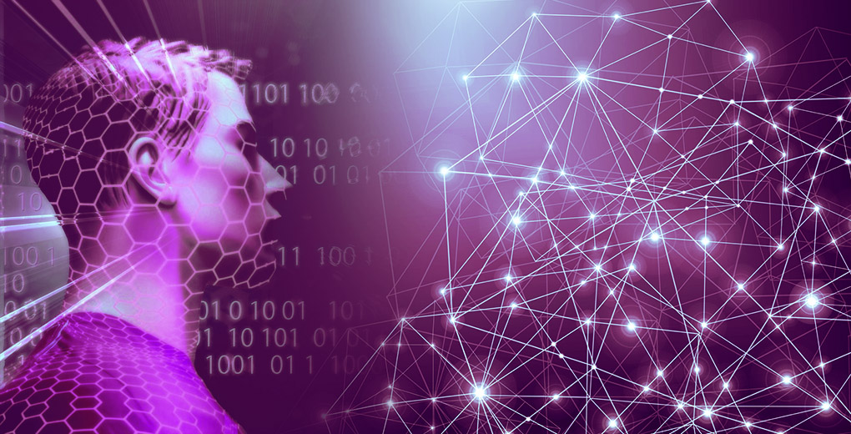
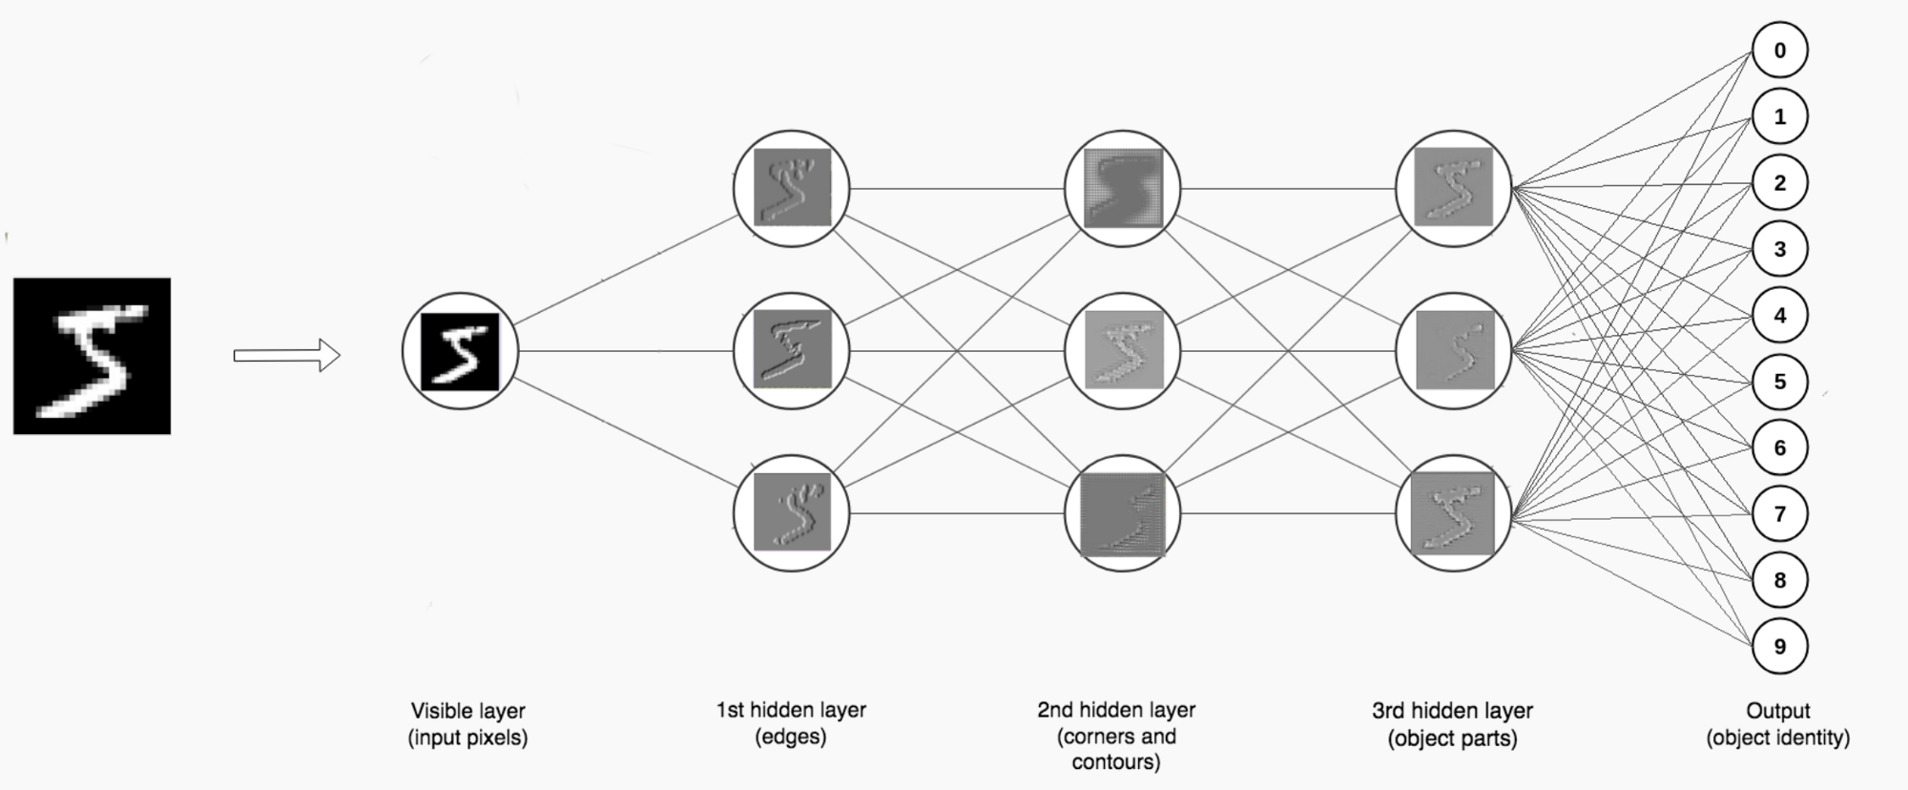
Artificial Neural Network
By
Dr. Hemant Palivela
Head of AI and ML
eClerx Services

Slide 2


Vice President – Data Science & Analytics
Domain Expertise:
Text Analytics, Voice Analytics, Computer Vision, Artificial Intelligence, Machine learning model design and development, Data Science platform and product design
Hemant has been awarded the prestigious 40 under 40 Data Scientists by Analytical India Magazine 2021
Hemant has rich experience in Data Science Solution development across multiple industries like Hospitality, Retail, Technology and Insurance. He has delivered scalable ML/AI platforms to clients across APJ, EMEA, US and Australia.
He has been instrumental in developing multiple novel analytics solutions during his tenure that has led to significant efficiency and revenue gains for clients who were already industry leaders and pioneers in leveraging data science driven solutions
In his current role, he manages multiple projects that require innovation and development in areas of NLP, Attribution models, Market Mix models, Forecasting, AI driven bots and owns the .AI suite design and development for eClerx
Prior to eClerx, he has also led and managed entire advanced analytics space for various Insurance and Hospitality clients
Hemant holds a Bachelor’s degree in Computer Engineering, Master’s degree in Computer Engineering and has submitted thesis for PhD in Computer Engineering.
He has published 45+ research papers in International conferences and Journals indexed by Scopus and SCI
Dr. Hemant Palivela
Role: Program Head– Data Science and AI
Total Experience: 9+ Years
Geographic Location: Mumbai, India

Slide 3


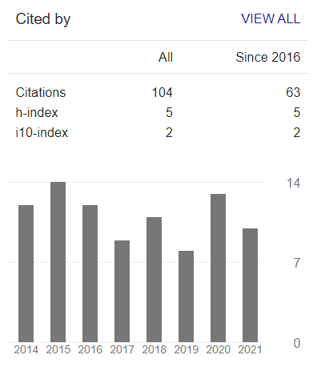

Introduction and Career Path
Principal areas of interest
Machine learning optimization
Linear Algebra
Published 42 research papers in International Conference and Journals.
Cited in Data Science Congress – Top 30
Cited in AI Accelerate Festival APAC - December 1-3, 2020
Reviewer of IEEE Transactions and many other prestigious Journals
05
Head of Artificial Intelligence and Machine Learning
Hemant Palivela
04
Data Scientist
eClerx Services - USA
03
Machine Learning Engineer
Citations
eClerx Services
02
Faculty in IT Department
01
Faculty in CE Department
Aureus
Analytics
NMIMS
University
Mumbai
University
Top Data Scientist by Analytics India Magazine
My Journey

Slide 4
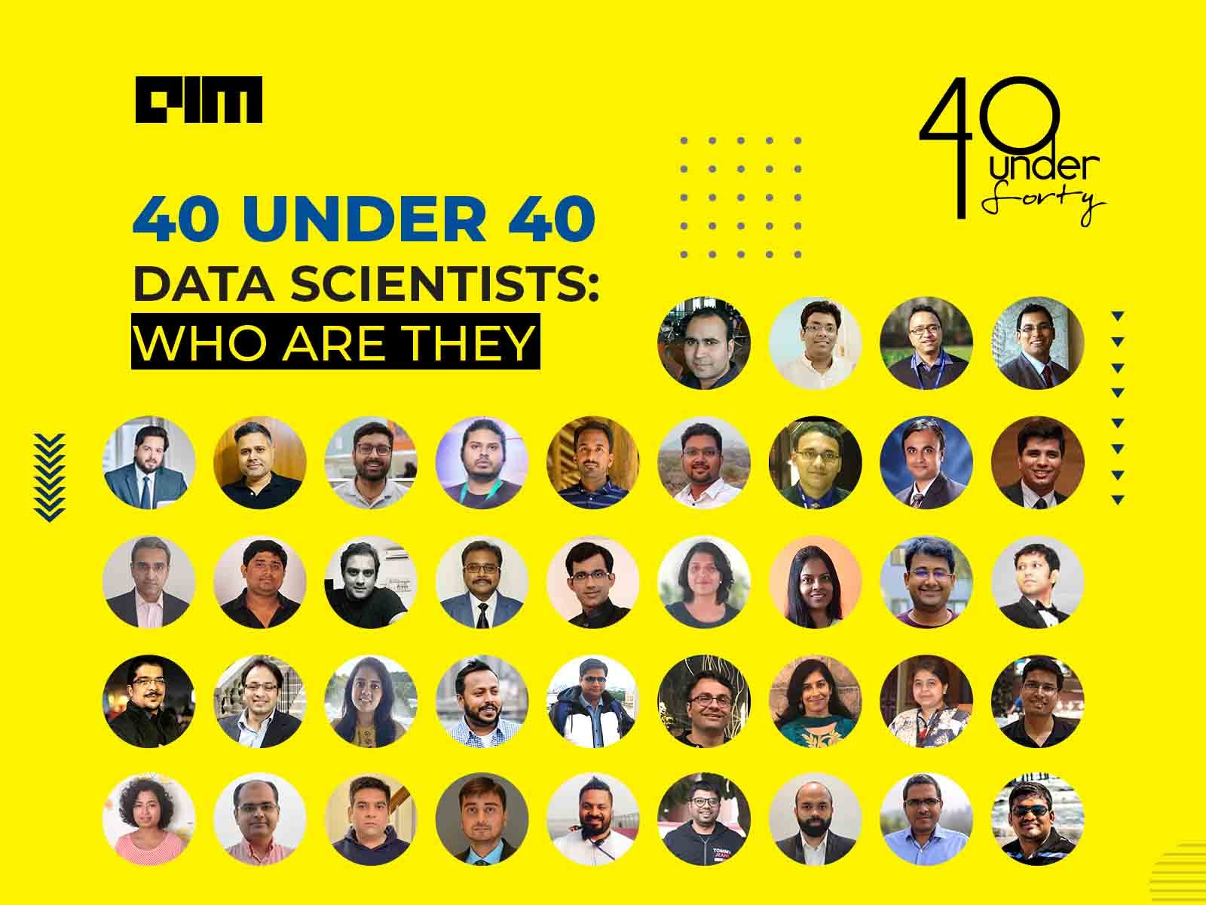

Slide 5
Syllabus
3 July 21
4 July 21
10 July 21
11 July 21
17 July 21
Timings(10 am to 4.00pm)
Day | Content
Day 1 | Artificial Neural Networks, Limitations of Vanilla Neural Networks, Introduction to Deep Learning, Deep Learning Architectures, Neural Network implementation using keras
Day 2 | Convolutional Neural Networks - Convolutional Layers, Pooling Layers, Fully Connected Layers, Softmax Activation Function, Implementing CNN using keras
Day 3 | Dropout, VGGNet, Transfer Learning, Implementing Transfer Learning using keras
Day 4 | Generative Adversarial Networks, Implementing GAN using Keras
Day 5 | Recurrent Neural Networks, Named Entity Recognition using RNN, Implementing Named Entity Recognition using Keras

Slide 6
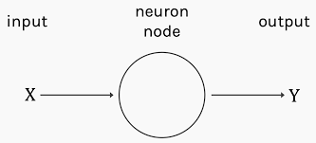
Artificial Neural Networks
ANN
Use cases
Types of neural networks
Feed-forward neural networks
signal processing
weather prediction
Recurrent neural networks
pattern recognition
Convolutional neural networks
facial recognition
credit rating firms
Modular neural networks

Slide 7
Advantages:
Disadvantages:
Parallel processing abilities mean the network can perform more than one job at a time.
Information is stored on an entire network, not just a database.
The ability to learn and model nonlinear, complex relationships helps model the real-life relationships between input and output.
Fault tolerance.
Gradual corruption.
The ability to produce output with incomplete knowledge with the loss of performance being based on how important the missing information is.
No restrictions are placed on the input variables.
ANN can learn from events and make decisions based on the observations.
The ability to learn hidden relationships in the data without commanding any fixed relationship.
The ability to generalize and infer unseen relationships on unseen data.
The lack of rules for determining the proper network structure means the appropriate artificial neural network architecture can only be found through trial and error and experience.
The requirement of processors with parallel processing abilities makes neural networks hardware-dependent.
The network works with numerical information, therefore all problems must be translated into numerical values before they can be presented to the ANN.
The lack of explanation behind probing solutions is one of the biggest disadvantages in ANNs. The inability to explain the why or how behind the solution generates a lack of trust in the network.

Slide 8
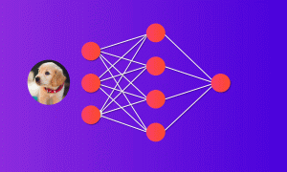
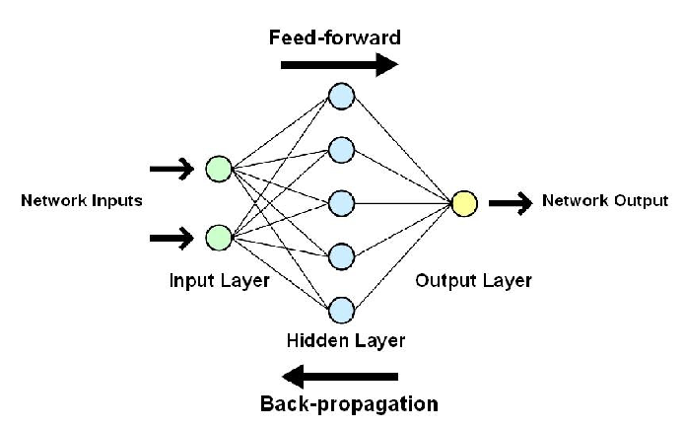
While solving an image classification problem using ANN, the first step is to convert a 2-dimensional image into a 1-dimensional vector prior to training the model. This has two drawbacks:
The number of trainable parameters increases drastically with an increase in the size of the image.
In the above scenario, if the size of the image is 224*224, then the number of trainable parameters at the first hidden layer with just 4 neurons is 602,112. That’s huge!
One common problem in all these neural networks is the Vanishing and Exploding Gradient. This problem is associated with the backpropagation algorithm. The weights of a neural network are updated through this backpropagation algorithm by finding the gradients.
Challenges
Notes:
https://pixabay.com/en/business-paperwork-deal-agreement-3152586

Slide 9
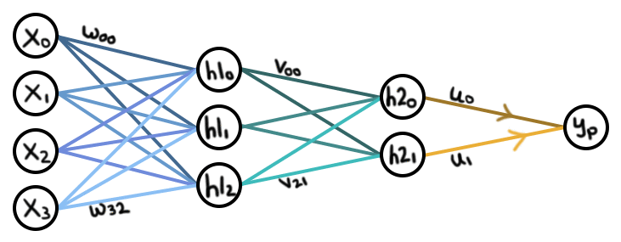
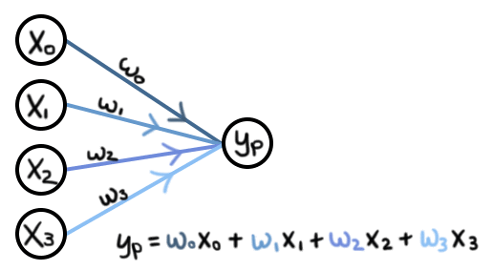
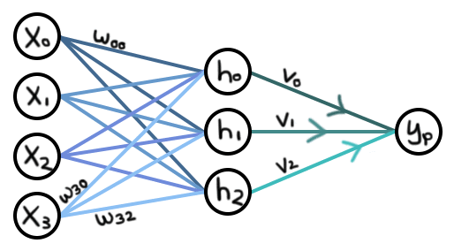
Vanilla Neural Networks
“Vanilla” neural networks: an extension of linear regression
A 2-layer “vanilla” Neural Network.
Figure 2 — Linear regression
Figure 3 — A “vanilla” NN, with an additional layer.

Slide 10
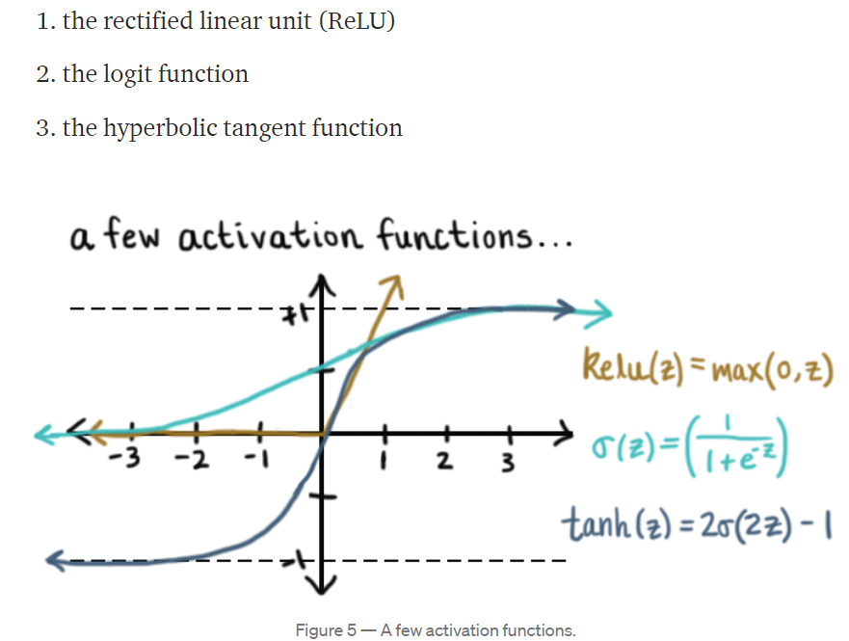
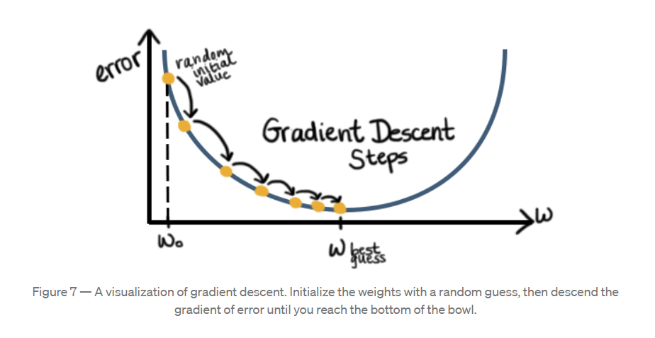
Vanilla Neural Networks
Activation functions: universal approximators
Backpropagation: how to train your dragon

Slide 11
Vanilla Neural Networks
Finally, there are many different variations of the update equation above. Each variant is called an “optimizer.”
There is a plethora to choose from:
Gradient Descent (GD)
Stochastic Gradient Descent (SGD)
Mini Batch Gradient Descent.
Optimizers within the GD family are usually challenged in that the learning rate must be defined a priori and they can get stuck in local minima or around saddle points if the error function is not convex (as it is for linear regression).
A better alternative is to choose an optimizer that utilizes an “adaptive learning rate,” such as AdaGrad, AdaDelta, RMSProp, or Adam.
Figure — Several optimizers as applied to Beale’s function. The gray star indicates the location of the global minimum.

Slide 12
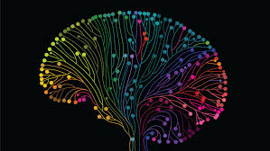

It is inspired by the human brain functionalities called artificial neural networks.
Teaches computers to do things humans do everyday.
Example: driverless cars, enabling them to recognize a stop sign, or to acknowledge a pedestrian and most of all not hit people in the way.
Deep Learning
Notes:
Image Source:-
https://pixabay.com/en/office-home-house-desk-chair-lamp-1078869/
https://pixabay.com/en/mountain-top-adventure-hiking-984083/

Slide 13
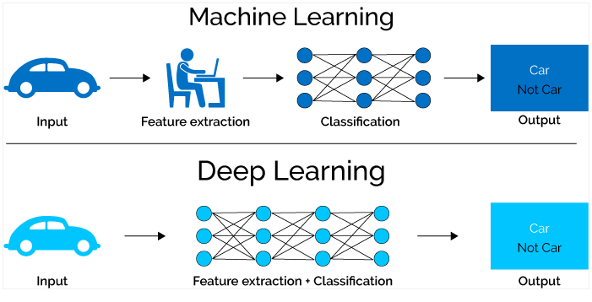
How is ML and DL different from each other ?

Slide 14
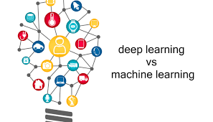
What are their roles?
ML
DL
specific types of programming tasks related to artificial intelligence.
Their goal is to develop programming systems that mimic brain functions.
Develop machine learning applications
Work on datasets and data representation methods
Run machine learning tests and experiments
Perform statistical analysis and fine-tuning using test results
Train and retrain systems

Slide 15
Basic working of Deep Learning
After the neural network passes its inputs all the way to its outputs, the network evaluates how good its prediction was through a loss function.
A neural network is composed of input, hidden, and output layers all of which are composed of “nodes”
Tries to learn the association/pattern between given inputs and outputs , this in turn allows model to generalize to inputs that it hasn’t seen before.
Given a large dataset of input and output pairs, a DL algorithm will try to minimize the difference between its prediction and expected output.

Slide 16
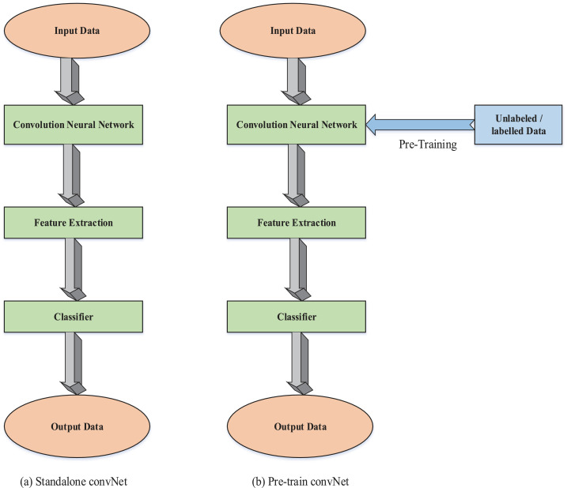
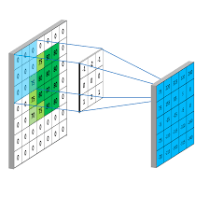
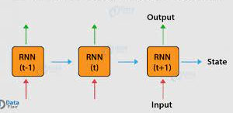
Deep Learning Categories and Architectures
Convolutional Neural Networks (CNNs)
Pretrained Unsupervised Networks
Recurrent and Recursive Neural Networks

Slide 17






Use cases of Deep learning:
Email filtering
06
Agriculture
Automotive
02
01
05
Banking
04
03
Healthcare
Industries

Slide 18
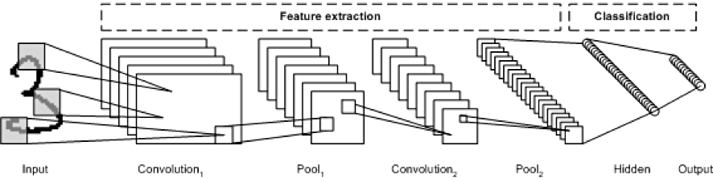
Convolutional Neural Networks (CNNs)
CNNs are inspired by biological processes and are designed to mimic the neural connectivity found in the brain’s visual cortex.
The architecture is particularly useful in image-processing applications.
As a deep network, early layers recognize features (such as edges), and later layers recombine these features into higher-level attributes of the input.

Slide 19
Examples of advanced Convolutional Neural Networks
LeNet
AlexNet
First successful application of convolutional networks and was developed by Yann LeCun in the 1990s.
Of the CNNs, the best known is the LeNet architecture which was used to read zip codes, digits, etc.
The latest work is called LeNet-5 which is a 5-layer CNN that reaches 99.2% accuracy on isolated character recognition.
Developed by Alex Krizhevsky, Ilya Sutskever and Geoff Hinton for the University of Toronto .
The main difference is that AlexNet has multiple convolutional layers followed by a POOL layer.
It contains eight main layers, where the first five layers are convolutional layers and the last three layers are fully connected layers.
ResNet
GoogLe-
Net
Residual Neural Network was proposed by Microsoft Research.
The layers are reformulated while learning residual functions instead of unreferenced functions.
As a result these residual networks are easier to optimize and gain considerable accuracy from increasing network depth.
Designed by Szegedy et al. from Google.
It is a much deeper CNN compared to AlexNet; GoogLeNet contains 22 layers Deep Learning Architectures 7 compared to AlexNet’s 8 layers.
GoogLeNet’s main contribution is the development of an inception layer that reduces the number of parameters in the network.

Slide 20

Pretrained Unsupervised Networks
PUN is a deep learning model that uses unsupervised learning to train each of the hidden layers in a neural network to achieve a more accurate fitting of the dataset.
An unsupervised learning algorithm is used to train each layer one at a time, independently, while using the previously trained layer as the input.
After the pre-training is done on each layer, a fine-tuning step is performed on the whole network using supervised learning.
Types of PUNs include
Autoencoders
Deep Belief Networks (DBN)
Generative Adversarial Networks (GAN)

Slide 21
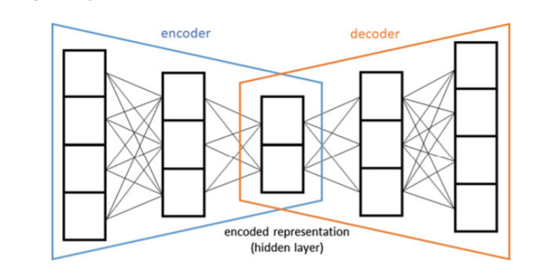
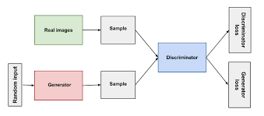
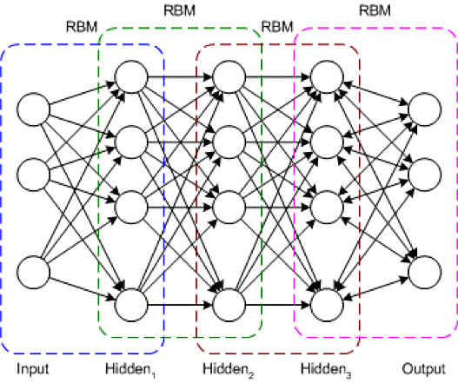
Autoencoders use unsupervised learning to learn a representation for dimensionality
reduction where the input is the same as the output
Generative Adversarial Networks (GAN) was first introduced by Ian Goodfellow in 2014. GANs are able to mimic any distribution of data in any domain: images, music, speech, and prose. A GAN network is made up of a discriminator, D, and a generator, G, which operate in parallel.
Deep Belief Network (DBN) is structured by connecting multiple, smaller unsupervised neural networks, and forms an extensive layered connection. The DBN is (typically deep and including many hidden layers) in which each pair of connected layers is an Restricted Boltzmann Machine (RBM)

Slide 22
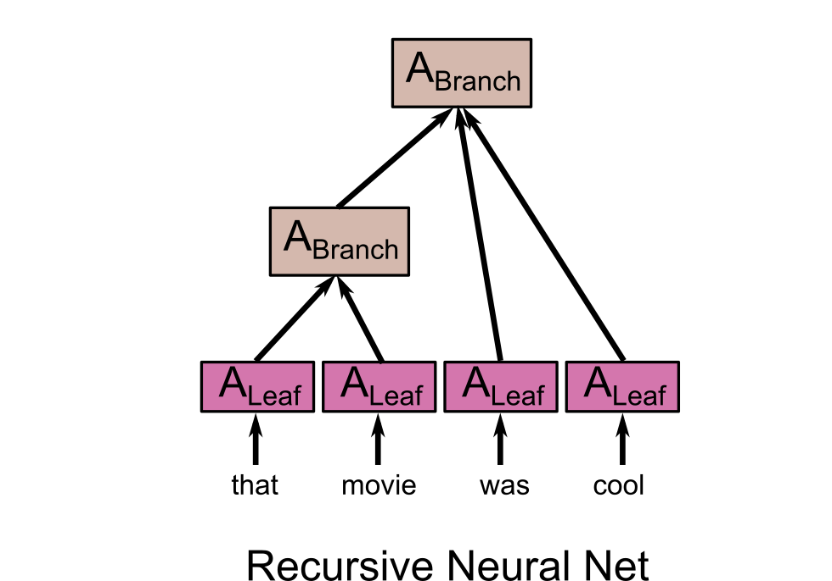

Recurrent and Recursive Neural Networks
This class of deep learning structures has the ability to send data over time steps.
4 structures in this class:
Recurrent Neural Network
Recursive Neural Network
Long Short-term Memory (LSTM)
Attention.

Slide 23

Based of the works of David Rumelhart in 1986.
RNNs are heralded for their ability to process and obtain insights from sequential data.
Therefore, video analysis, image captioning, natural language processing (NLP), and music analysis all depend on the capabilities of recurrent neural networks.
RNNs actively capture sequential and time dependencies between data.
Are a set of non-linear adaptive models which are used to process data of variable length.
They are especially proficient in processing data structure inputs.
Recursive networks feed the state of the network back into itself, in what can be viewed as a loop.
Recurrent Neural Network
Recursive Neural Network
Types
Attention
Attention networks use an additional “attention” mechanism that is growing in popularity among numerous architectures.
LSTM
Introduced in 1997 by Hochreiter and Schmidhuber and works well on making predictions based on time series data, avoiding the long-term dependency problem that traditional, or vanilla, RNNs were plagued with.

